Slide 1
Novel Nexus
Helping Debut Authors get Published
Andrew Mooney

Slide 2

Who am I?
Writer, word enthusiast
Data Scientist, number enthusiast
Huge Science Fiction and Fantasy fan
Unsuccessfully tried to find an agent for 4 separate novels

Slide 3
1.
Writer’s Roadblock
When good books gather dust, not readers

Slide 4
Who Wants Your Book?
Writing and rewriting is incredible and rewarding…but who is going to buy your book?
Who is your target demographic?
What genre does it fit into?
What books is it similar to?

Slide 5

Finding a Literary Agent
Why? They your industry champion
Most publishing houses won’t consider unsolicited manuscripts
Finding them is hard. Most popular books’ agents aren’t looking for debut authors
You need to write a kickass query letter
It all starts with a BLURB

Slide 6
“Literary agents don’t take on every potential client who wants representation – unlike a lawyer or an accountant – because agents don’t get paid unless their clients get paid. So they need to be blown away or ‘hooked’ on a potential client’s project to take it on”
- Robert Lee Brewer, Writer’s Digest

Slide 7
2.
Novel Nexus
A tool for finding agents

Slide 8

What Does it Do?
Tells you the major Science Fiction subgenres and age demographics of your book blurb
Tells you what words affected your scores to help you edit your work
Tells you the top 10 books with the most similar descriptions to help you research agents

Slide 9
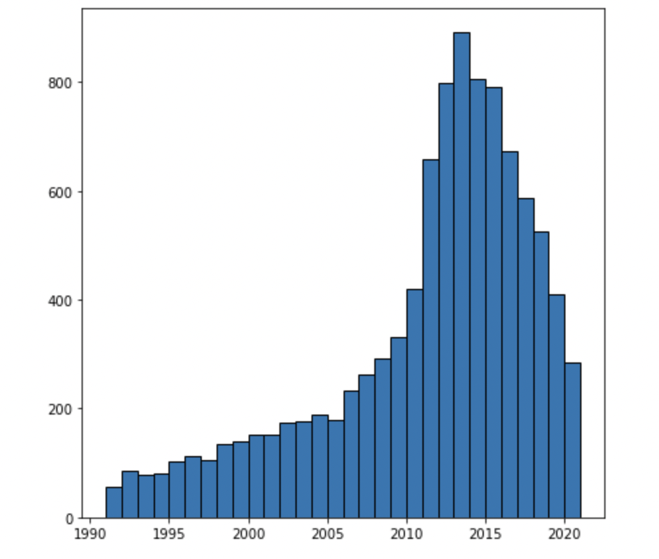
How Does it Work?
Uses Natural Language Processing and machine learning to score your book description.
Trained on 11,000 science fiction novels on Goodreads, mostly published in the last 30 years
Uses TF-IDF vectorization – doesn’t care about syntax, just words used

Slide 10
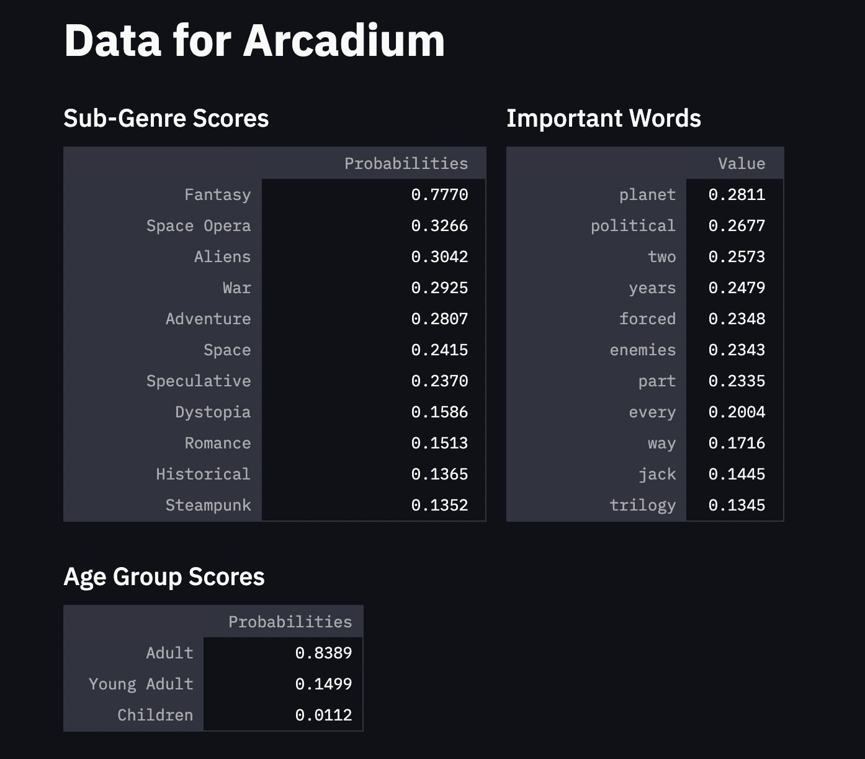
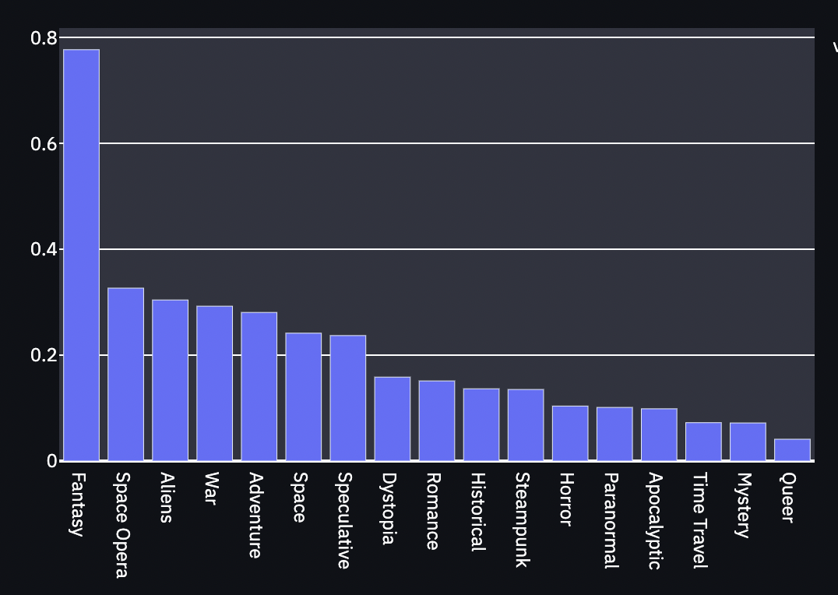

Slide 11
Finding an Agent is Hard
You should use every tool available to you to make sure you find the right agent for you

Slide 12
3.
Next Steps
More than just Science Fiction

Slide 13
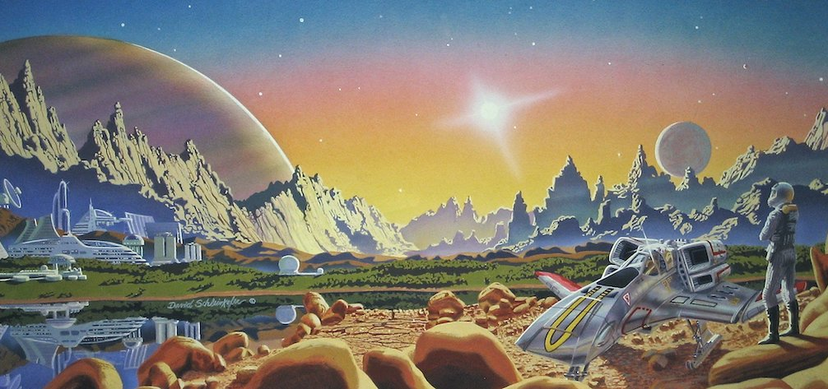
There’s More Coming!
With an expanded dataset, we can identify books from other genres like mysteries, thrillers and literary fiction
If agent information could be included, such as openness to submissions, it could become very powerful

Slide 14
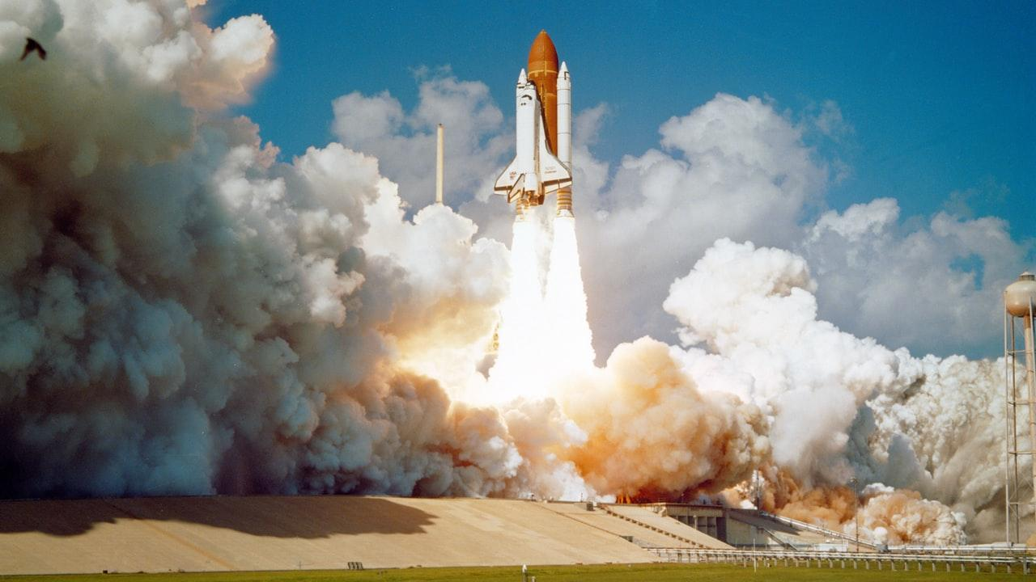
Sometimes the hardest part is knowing where to start

Slide 15
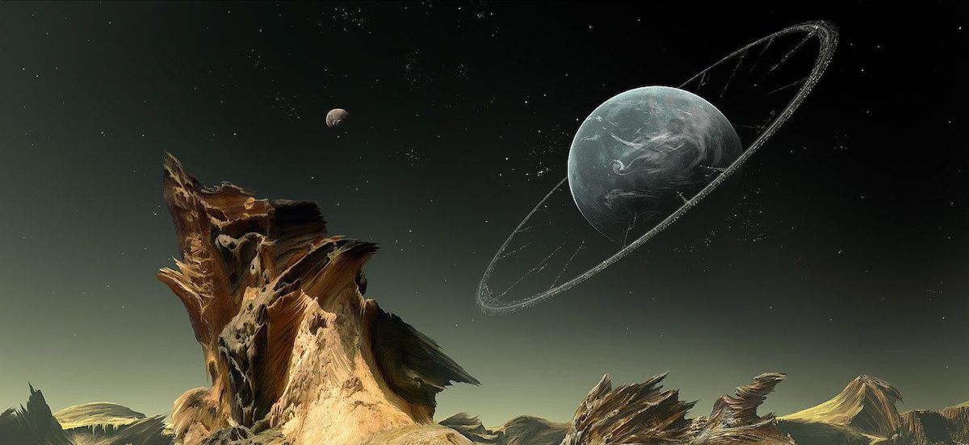
Thank You!
Any questions? You can find me at:
andrew.k.mooney@gmail.com
github.com/andrewkmooney/ Novel_Genres

